Slide 1
Welcome

Slide 2
History
Android is a mobile operating system developed by Google, based on the Linux kernel and designed primarily for touchscreen mobile devices.
Initially developed by Android Inc., which Google bought in 2005, Android was unveiled in 2007, along with the founding of the OHA a consortium of hardware, software, and telecommunication companies.
Google has further developed Android TV for televisions, Android Auto for cars, and Android Wear for wrist watches.
Variants of Android are also used on notebooks, game consoles, digital cameras, and other electronics.
First commercial Android device in September 2008, the operating system has gone through multiple major releases, with the current version being 7.0 "Nougat"

Slide 3
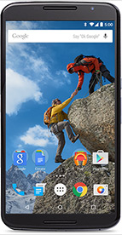
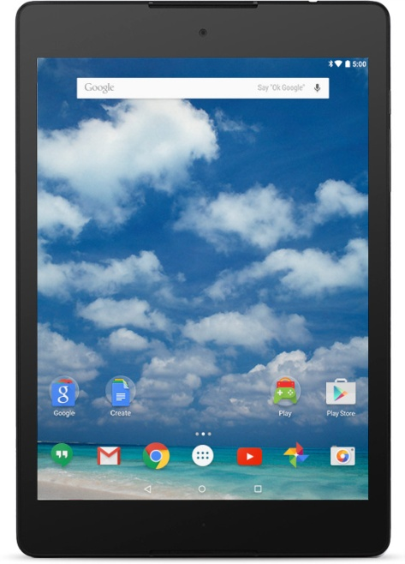
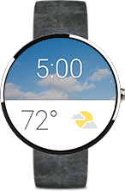


Where we are Using Android
Mobile
Wear
Android TV
Tablet
Android Auto

Slide 4
Core Building blocks of Android
Activity is like a frame or window in java that represents GUI. It represents one screen of android.
View A view is the UI element such as button, label, text field etc. Anything that you see is a view.
Intent Used to perform the inter connection between activities and the data passing mechanism.
Service is a component that runs in the background. It is used to play music, handle network transaction etc.
Content Provider Content providers are used to share information between android applications.
Fragment Fragment is a part of Activity. By the help of fragments, we can display multiple screens on one activity.

Slide 5
Abbreviation
AAPT is an acronym for Android Asset Packaging Tool. It handles the packaging process.
AIDL is an acronym Android Interface Definition Language converts any. Aidl interfaces into java interfaces.
ADB stands for Android Debug Bridge. It is a command line tool that is used to communicate with the emulator instance.
NDK stands for Native Development Kit. By using NDK, you can develop a part of app using native language such as
C/C++ to boost the performance.
ADT stands for Android development tool,This is useful to develop the applications and test the applications.

Slide 6
ANR stands for Application Not Responding. It is a dialog box that appears if the application is no longer responding.
APK is a short form stands for Android Packaging Key. It is a compressed key with classes,UI's, supportive assets and manifest.
All files are compressed to a single file is called APK.
AVD stands for Android Virtual Device used to test the android application without the need for mobile or tablet etc. It can be created in different configurations to emulate different types of real devices.

Slide 7
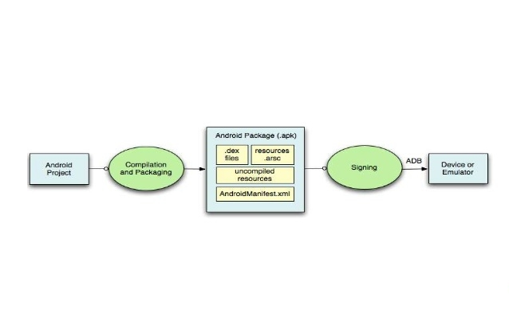
Build Process

Slide 8
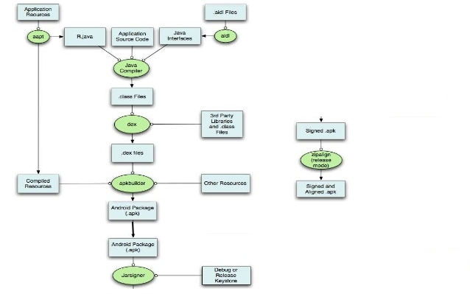

Slide 9
Explination
AAPT coverts Android Application resource files such as Android Manifest.Xml Xml files of User Activities,compiles them and generates R. Java
AIDLconverts any. Aidl interfaces into java interfaces.
Java compiler compiles all these R. java, User Activity java classes and converted. Aidl interfaces and generates. class files.
dex (Dalvik Executable) tool converts these. Class files and any 3rd party library files into. Dex files.
. dex files will be in Dalvik byte code.
All non-compiled resources (such as images compiled resources and. Dex files are packaged into an. Apk file by apkbuilder.
Once the. Apk file is built, it must be signed with either a debug or release key before it can be installed to a device.
Finally, if the application is beir, g signed in release mode, you must align the. Apk file with the zipalign tool.
Aligned final. Apk file decreases the memory usage when the application is r inning on a device.

Slide 10
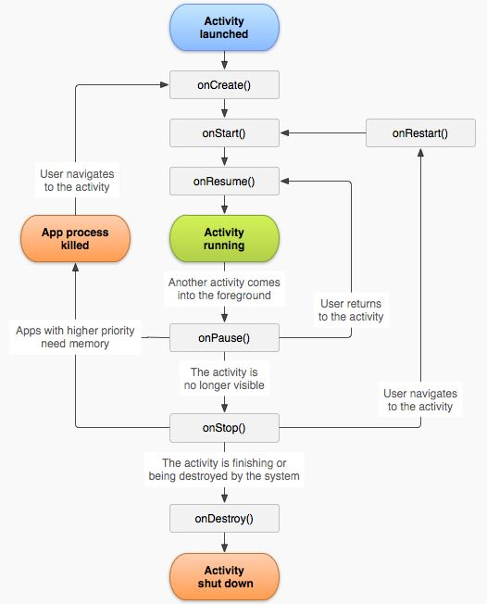
Android Life Cycle
onCreate called when activity is first created.
OnStart called when activity is becoming visible to the user.
OnResume called when activity will start interacting with the user.
OnPause called when activity is not visible to the user.
OnStop called when activity is no longer visible to the user.
OnRestart called after your activity is stopped, prior to start.
OnDestroy called before the activity is destroyed.

Slide 11
Code name | Version number | Initial release date | API level
Astro | 1 | September 23, 2008 | 1
Bender Boy | 1.1 | February 9, 2009 | 2
Cupcake | 1.5 | April 27, 2009 | 3
Donut | 1.6 | September 15, 2009 | 4
Eclair | 2.0–2.1 | October 26, 2009 | 5–7
Froyo | 2.2–2.2.3 | May 20, 2010 | 8
Gingerbread | 2.3–2.3.7 | December 6, 2010 | 9–10
Honeycomb | 3.0–3.2.6 | February 22, 2011 | 11–13
Ice Cream Sandwich | 4.0–4.0.4 | October 18, 2011 | 14–15
Jelly Bean | 4.1–4.3.1 | July 9, 2012 | 16–18
KitKat | 4.4–4.4.4 | October 31, 2013 | 19–20
Lollipop | 5.0–5.1.1 | November 12, 2014 | 21–22
Marshmallow | 6.0–6.0.1 | October 5, 2015 | 23
Nougat | 7.0–7.1.2 | August 22, 2016 | 24–25
O | 8 | TBA | 26

Slide 12
Version Name | Key user features added | Key developer features added
Nougat 7.1.1 | Long press on the app icon enable new launch actions The default keyboard allows now to send GIFs directly New set of emojis
Nougat 7.1 | Daydream Virtual Reality mode Night Light Storage manager improvements Performance improvements for Touch and Display managements Option to enable fingerprint swipe down gesture Seamless system updates | Shortcut manager APIs Support Circular app icons Keyboard image insertion VR thread scheduling improvements Enhanced wallpaper metadata Multi-endpoint call support Source type support for Visual Voicemail Carrier config options to manage video telephony
Nougat 7.0 | Unicode 9.0 emoji Better multitasking Multi-window mode (PIP, Freeform window) Seamless system updates (with dual system partition) Better performance and code size thanks to new JIT Compiler | Sustained Performance Mode (SPM) API Vulkan 3D rendering API Daydream virtual reality platform

Slide 13
Version name | Key user features added | Key developer features added
Marshmallow 6.01. | New emojis
Marshmallow 6.01. | USB Type-C support Fingerprint Authentication support Better battery life with "deep sleep" Permissions dashboard Android Pay MIDI support Google Now improvements | Custom Chrome Tabs for better in app browser support App Permissions management update
Lollipop | Speed improvement Bug fixes
Lollipop | Multiple SIM cards support Quick settings shortcuts to join Wi-Fi networks or control Bluetooth devices Lock protection if lost or stolen High Definition voice call Stability and performance enhancements
Lollipop | Performance improvements and bug fixes
Lollipop | bug fixes, fix issues with video playback and password failures
Lollipop | New design (Material design) Speed improvement Battery consumption improvement | Several new API Tracking battery consumption app

Slide 14
Thank You

